Slide 1
Parallelizing Dijkstra’s Algorithm
IT388 Introduction to Parallel Processing Resources
Fall 2018
Cain Wock
Matthew Hill
Cody Ponder
Deidre Brennan

Slide 2
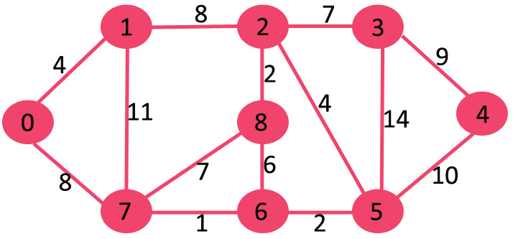
What is dijkstra’s Algorithm?
Dijkstras algorithm is for finding the shortest paths between nodes in a graph

Slide 3
How it works
Most implementations pick a “source” node and calculate the distance to other nodes.
By picking an unvisited vertex with the lowest distance, the algorithm calculates the distance through it to each unvisited neighbor and then updates the neighbors distance if it is smaller than the previous known distance.
Once a node has been visited, it will be marked so it cannot be visited again.

Slide 4
VISUAL AID
In this diagram, the root node is 1 and the destination node is 5
When the distance to a node has not yet been calculated, it is seen as infinite

Slide 5
Visual Aid
Node 2 is visited first because it has the shortest distance of 7
The distances of nodes 3 and 6 are then determined.

Slide 6
Visual Aid
14
Node 2 will be chosen as the new Base because it has the shortest distance
Node one will be marked so it can no longer be visited
9
1
2
7

Slide 7
Goals
Test a serial implementation of Dijkstra’s algorithm to create base run times
Code a parallelized implementation of Dijkstra’s algorithm
Analyze the parallelized implementation and examine what can be parallelized and what cannot.
Compare the serial vs. parallelized programs using their runtimes and determine if it is worth using parallelization

Slide 8
Aproach
The problem requires adjacent distances to be known when picking the next pivot node.
A node must have multiple connections in order for parallelization to be efficient
We will parallelize the process of finding distance to connected nodes for every pivot
Information will have to be given to a single process to pick the next node

Slide 9
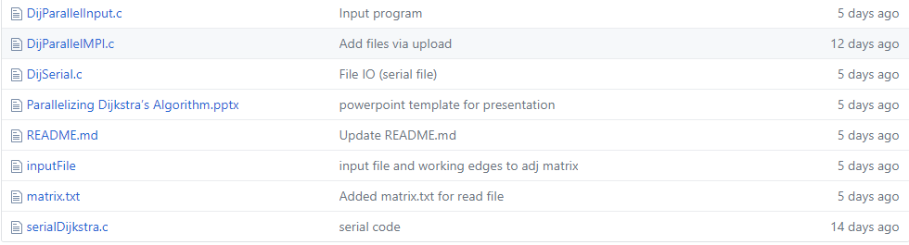
Preliminary outcomes
This file converts user input into
A format usable by our programs

Slide 10
These files take the input and solve
Using serial and parallel methods

Slide 11
Next STeps
We now plan to use results from both the parallel and the serial implementation of the algorithm to calculate speedup and efficiency
We want to narrow down the advantages/disadvantages of using parallelization here and define the context
We will then present our findings in a productive and usable format

